Slide 1

HR Analytics Project
A project by
Ton Vo Thu Uyen & Le Ngoc Uyen Phuong

Slide 2

Introduction
HR Analytics: measure the impact of HR metrics on the overall business performance
Turnover: an employee leaves a company for some reason
The company’s problem in the trainee classification
Main goal of the project

Slide 3



Development tools
Programming language: Python
Google Colab (Google Colaboratory)
Preprocessing
Visualization
Modeling
Pandas, Numpy
Category Encoders
Scipy stats
Matplotlib, Seaborn
Plotly
Missingno
(Sklearn), train_test_split,
StandardScaler, PCA
LogisticRegression, DecisionTreeClassifier

Slide 4

Table of Contents
1. Data Overview
2. Exploratory Data Analysis
3. Data Cleaning
Understand features and quality of the dataset
Understand features of the attributes
Handle missing values and outliers
4. Data Preprocessing
5. Data Analysis
6. Modeling
Transform and scale data for modeling
Analyze cleaned dataset to answer the questions
Build and test model to predict the target

Slide 5
01
Data Overview
Understand features & quality of the dataset

Slide 6
Attributes description
No. | Attribute | Description | Data type
1 | enrollee_id | Unique ID for candidate | int
2 | city | City code | string
3 | city _development _index | Development index of the city (scaled) | float
4 | gender | Gender of candidate | string
5 | relevant _experience | Relevant experience of candidate | string
6 | enrolled _university | Type of University course currently enrolled (if any) | string
7 | education _level | Education level of candidate | string
No. | Attribute | Description | Data type
8 | major _discipline | Education major discipline of candidate | string
9 | experience | Candidate total experience (years) | string
10 | company _size | Number of employees in current employer's company | string
11 | company _type | Type of current employer | string
12 | last_new _job | Difference in years between the previous job and current job | string
13 | training _hours | Training hours completed | int
14 | target | 0 – Stay, 1 – Leave | float

Slide 7
Dataset description
No. | Attribute | Data Type | Count | Missing Value | Unique Value
1 | enrollee_id | int | 19158 | 0 | 19158
2 | city | string | 19158 | 0 | 123
3 | city_development _index | float | 19158 | 0 | 93
4 | gender | string | 14650 | 4508 | 3
5 | relevant _experience | string | 19158 | 0 | 2
6 | enrolled _university | string | 18772 | 386 | 3
No. | Attribute | Data Type | Count | Missing Value | Unique Value
7 | education_level | string | 18698 | 460 | 5
8 | major_discipline | string | 16345 | 2813 | 6
9 | experience | string | 19093 | 65 | 22
10 | company_size | string | 13220 | 5938 | 8
11 | company_type | string | 13018 | 6140 | 6
12 | last_new_job | string | 18735 | 423 | 6
13 | training_hours | int | 19158 | 0 | 241
14 | target | float | 19158 | 0 | 2

Slide 8
02
Exploratory Data Analysis

Slide 9
Numerical attributes
 | count | mean | std | min | 25% (Q1) | 50% (Q2) | 75% (Q3) | max
enrollee_id | 19158.0 | 16875.36 | 9616.29 | 1.00 | 8554.25 | 16982.5 | 25169.75 | 33380.00
city_ development_index | 19158.0 | 0.83 | 0.12 | 0.45 | 0.74 | 0.9 | 0.92 | 0.95
training_hours | 19158.0 | 65.37 | 60.06 | 1.00 | 23.00 | 47.0 | 88.00 | 336.00
target | 19158.0 | 0.25 | 0.43 | 0.00 | 0.00 | 0.0 | 0.00 | 1.00

Slide 10
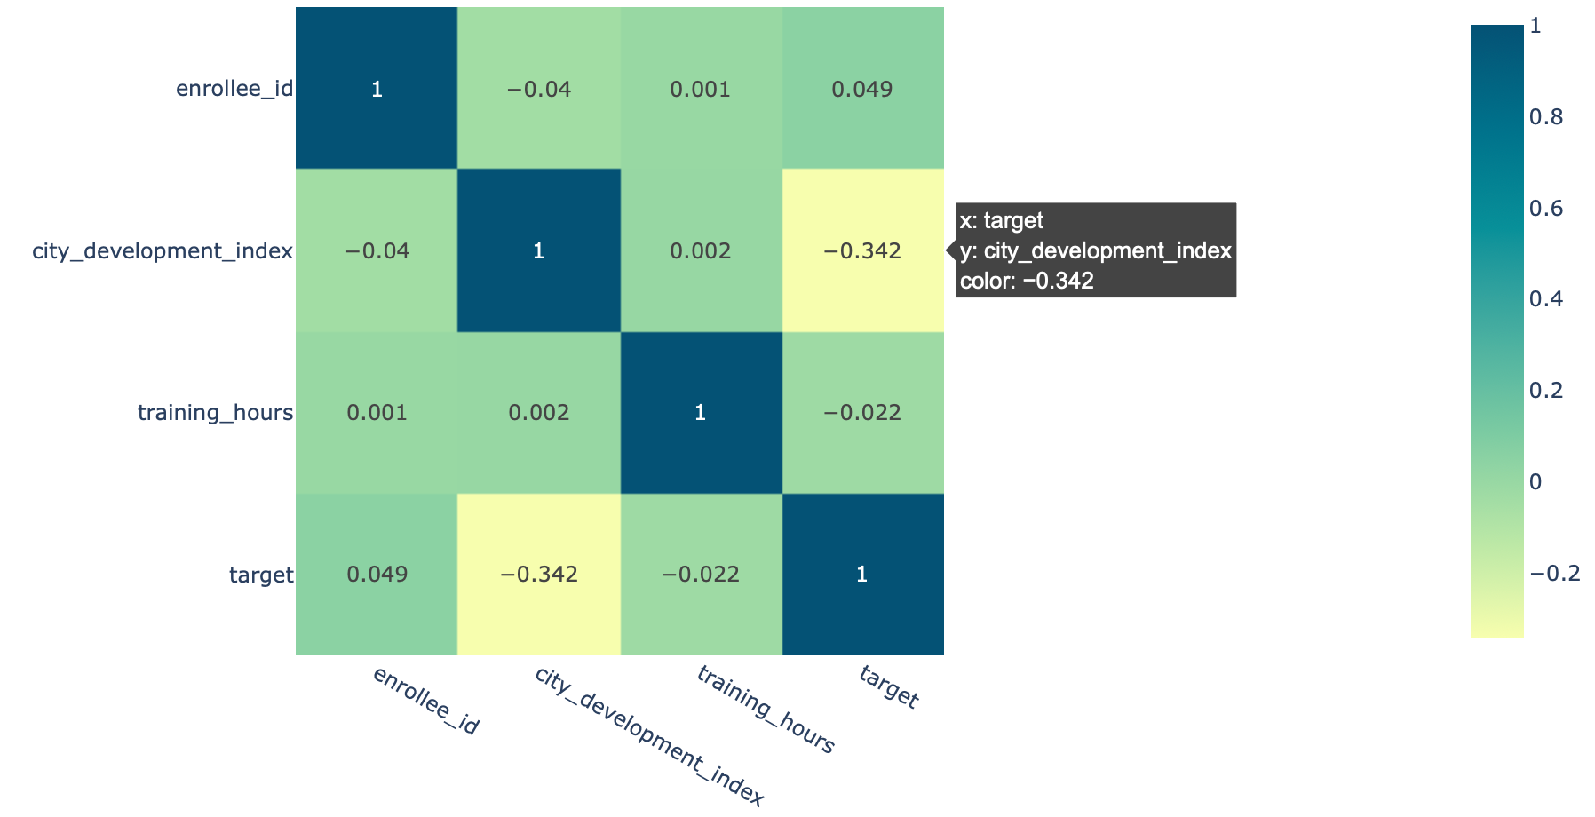
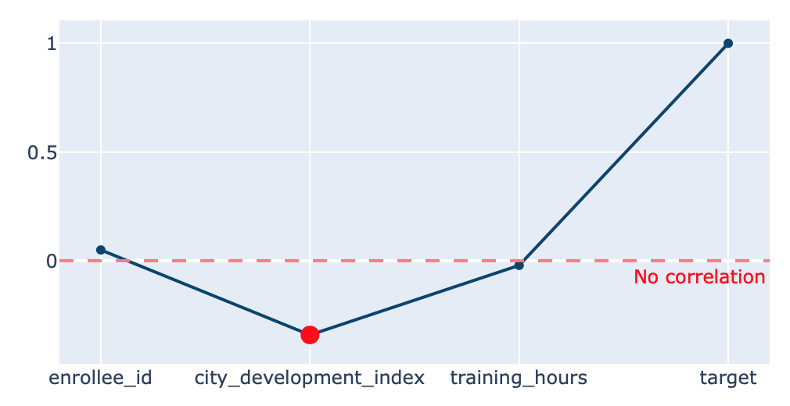
Numerical attributes
“city_development_index” vs. ”target” negative correlation

Slide 11
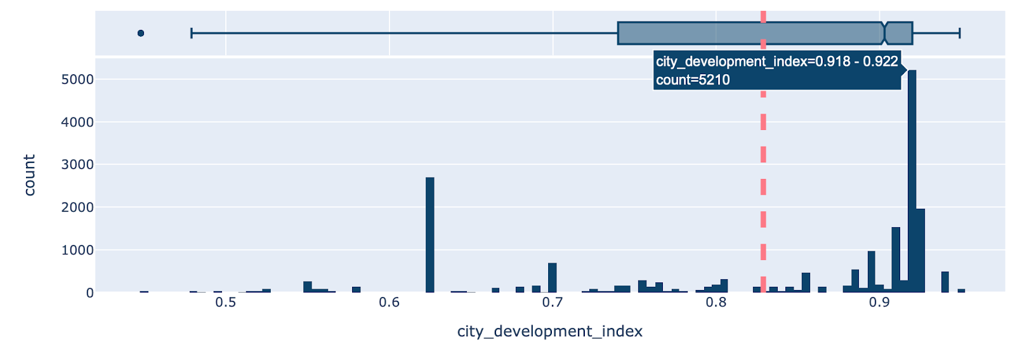
City Development Index (CDI)
Measure urban poverty & urban governance.
Rank cities around the world according to CDI
Value range [0, 100]

Slide 12

Categorical attributes
 | unique | top | freq | count
city | 123 | city_103 | 4355 | 19158
gender | 3 | Male | 13221 | 14650
relevant_experience | 2 | Has relevant experience | 13792 | 19158
enrolled_university | 3 | no_enrollment | 13817 | 18772
education_level | 5 | Graduate | 11598 | 18698
major_discipline | 6 | STEM | 14492 | 16345
experience | 22 | >20 | 3286 | 19093
company_size | 8 | 50-99 | 3083 | 13220
company_type | 6 | Pvt Ltd | 9817 | 13018
last_new_job | 6 | 1 | 8040 | 18735

Slide 13
Categorical attributes
 | Description | count | unique | top | freq | Unique values
experience | Candidate total experience (in years) | 19093 | 22 | >20 | 3286 | >20, 15, 5, <1, 11, 13, 7, 17, 2, 16, 1, 4, 10...
company_ size | Number of employees in current employer's company | 13220 | 8 | 50-99 | 3083 | nan, 50-99, <10, 10000+, 5000-9999, 1000-4999,...
last_ new_job | Difference in years between previous and current job | 18735 | 6 | 1 | 8040 | 1, >4, never, 4, 3, 2, nan

Slide 14
03
Preprocessing: Data Cleaning

Slide 15
Extract columns, drop odd strings, correct dtype
3.1
Delete special characters
Correct Data Types
Drop unecessary columns
Math symbols make it impossible for calculation
Not every column is worth dealing with..
Set all attributes in their correct form.

Slide 16
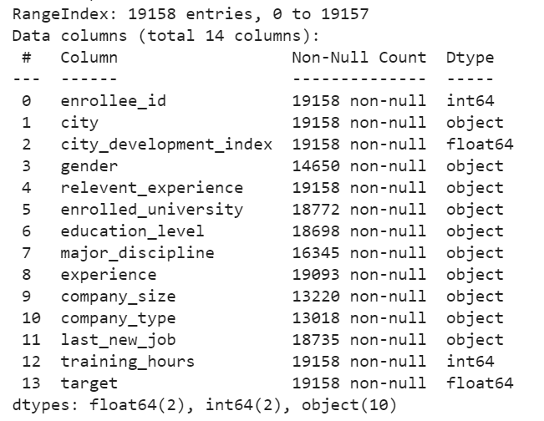
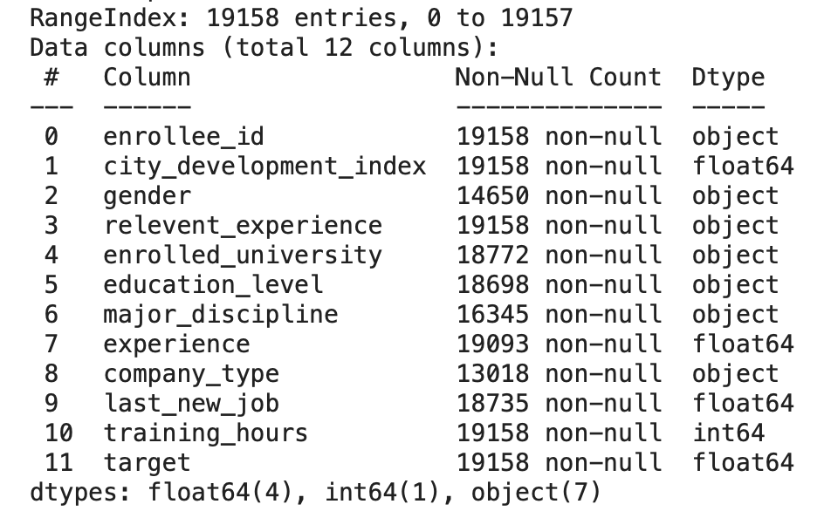
All data types before and after cleaning

Slide 17
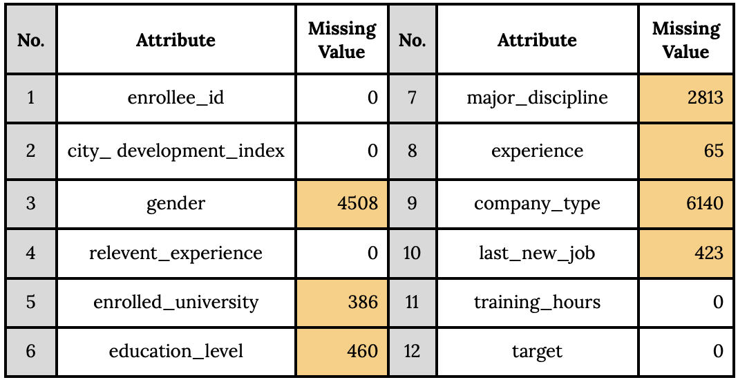
Dealing with missing values
3.2
Fill by “Unknown”
Fill by mean

Slide 18
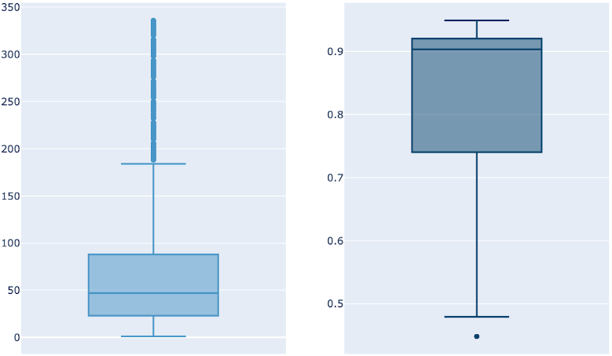
3.3 Dealing with outliers (numeric values)
training_hours
city_development_index

Slide 19
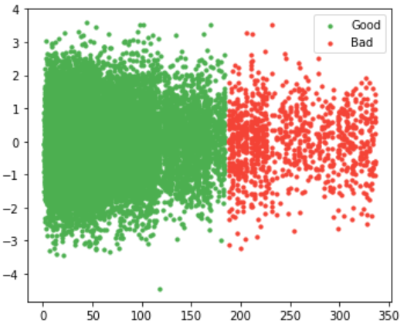
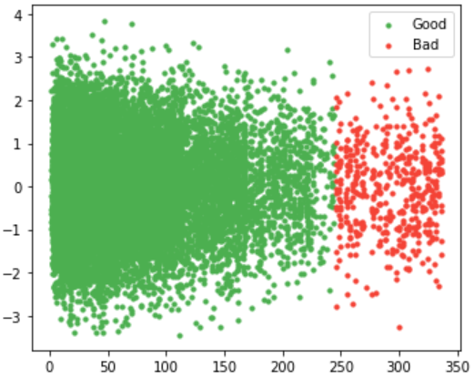
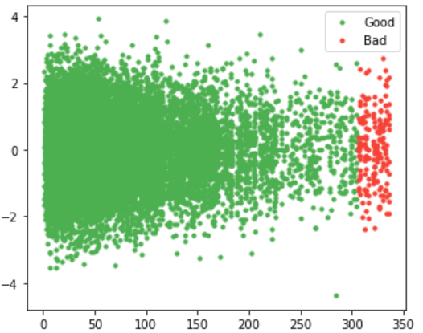
3.3 Dealing with outliers (numeric values)
threshold = 2
threshold = 3
threshold = 4

Slide 20
04
Preprocessing: Transformation
Crucial step right before modeling

Slide 21


Data Transformation consist of :
1
2
Encoding categorical data
Nominal columns
Ordinal columns
Features Scaling
Standard Scaler

Slide 22
Data Transformation consist of :
1
Encoding categorical data
Nominal columns
Ordinal columns

Slide 23
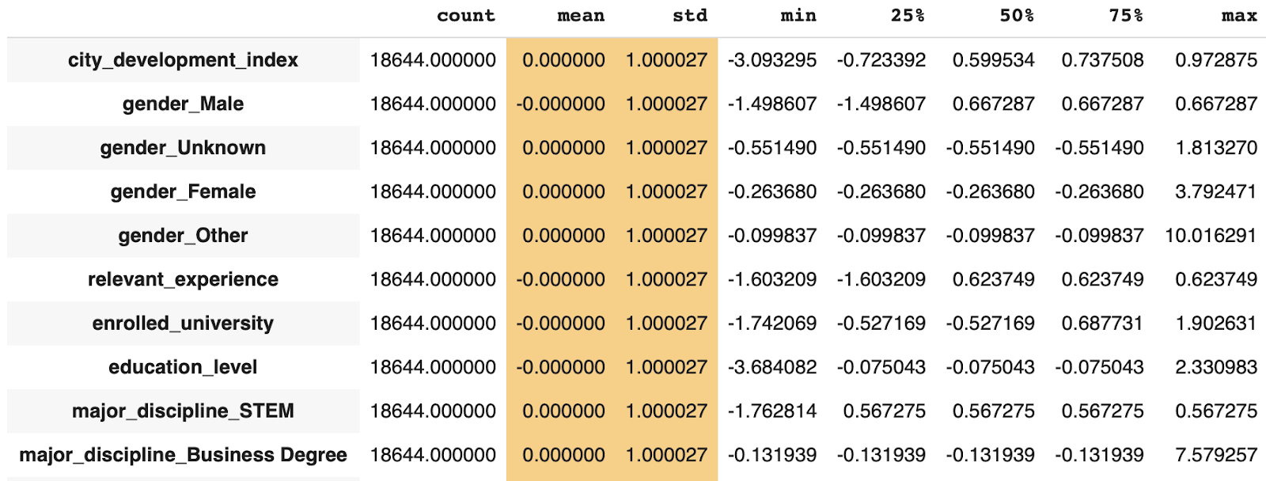
2
Features Scaling (Standard Scaler)
Remove the mean
Set unit variance

Slide 24
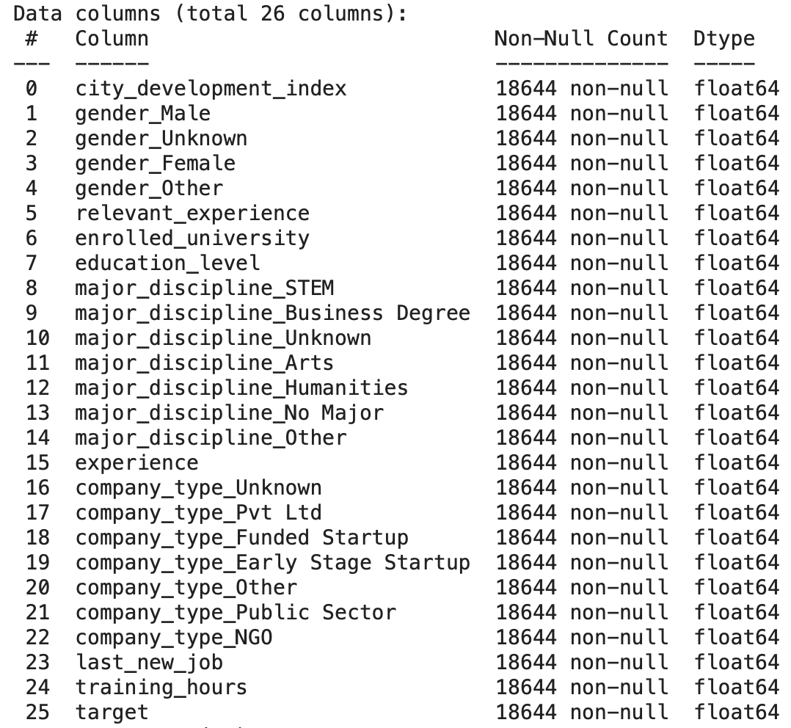
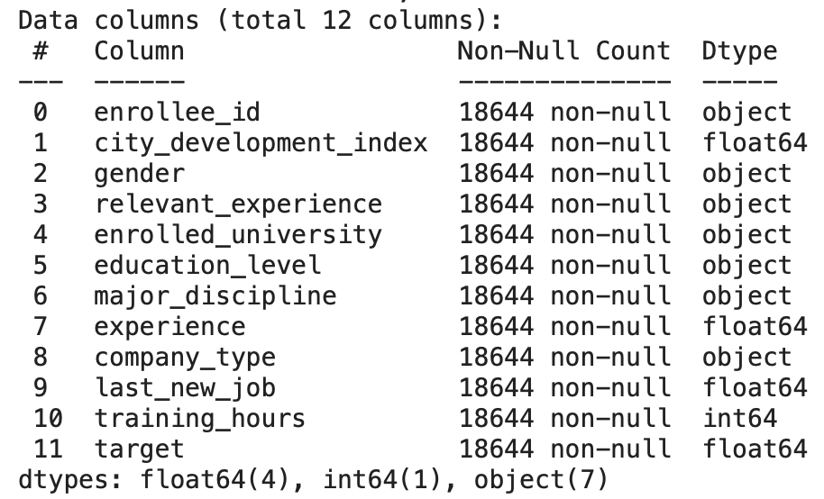
Dataset Description (new)
12 columns --> 26 columns

Slide 25
05
Descriptive Analysis

Slide 26
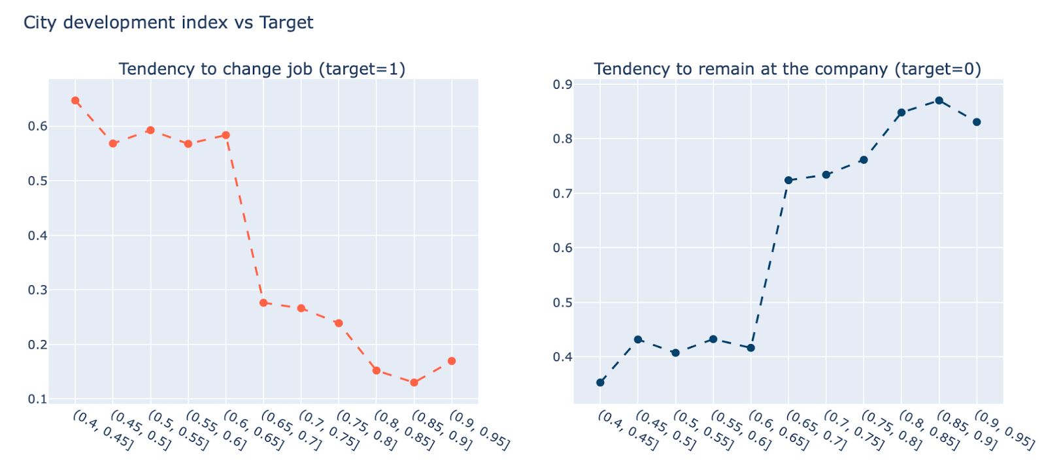
Q1: Does city development statistics affect the job decision of the trainees?

Slide 27
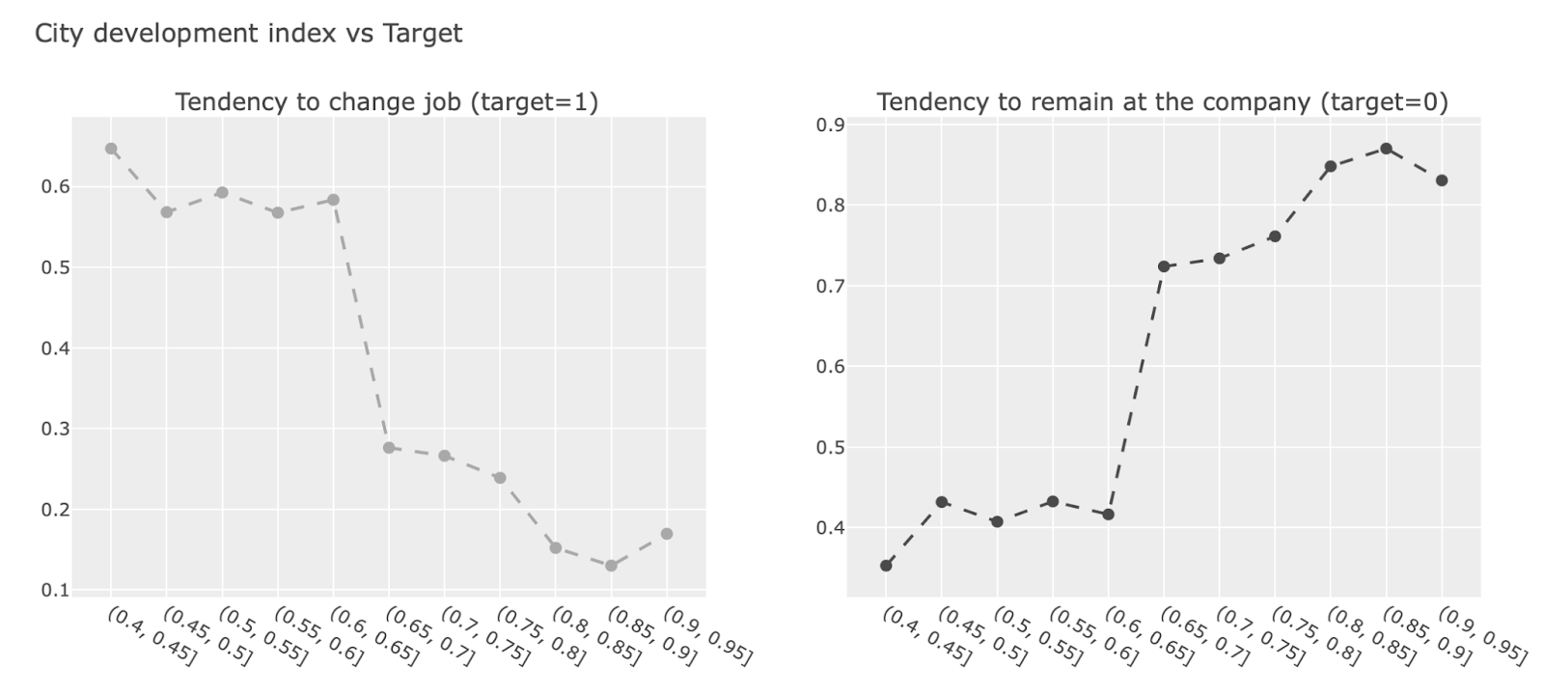
Higher CDI, stronger tendency to stay Q1: Does city development statistics affect the job decision of the trainees?

Slide 28
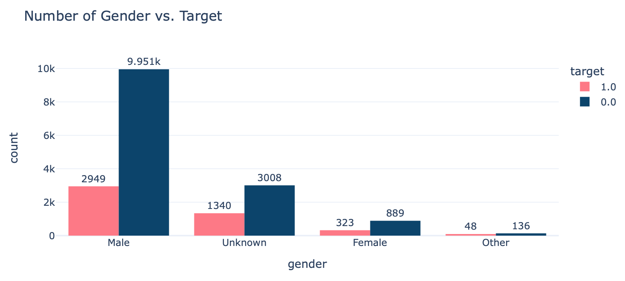
Q2: Which gender prefers to stay with the company after training courses?

Slide 29
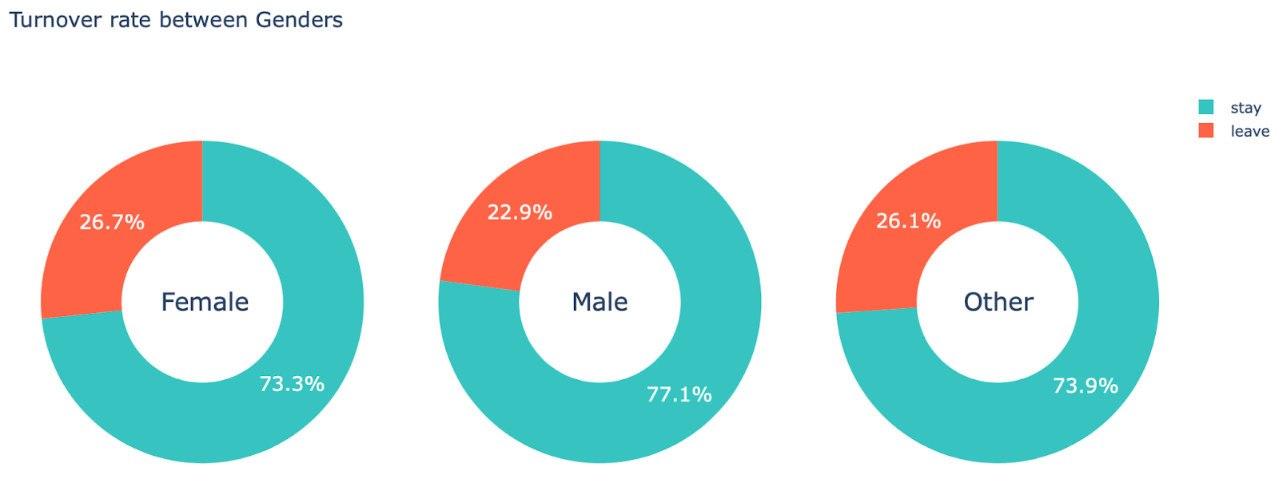
Male is more likely to stay. Q2: Which gender prefers to stay with the company after training courses?

Slide 30
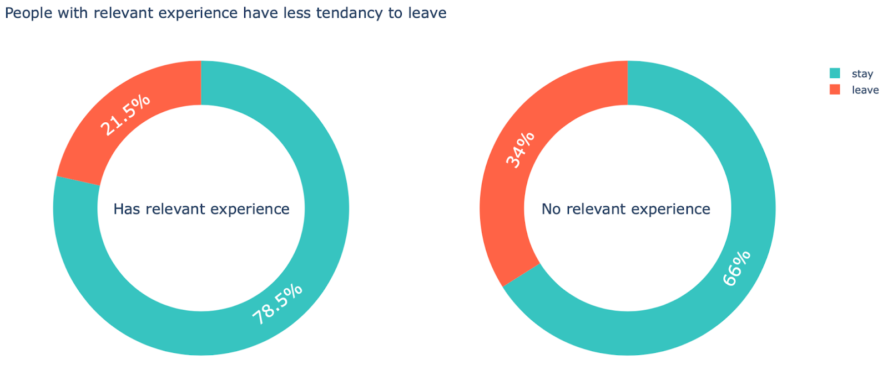
Q3: Is relevant experience in the data science field required?

Slide 31
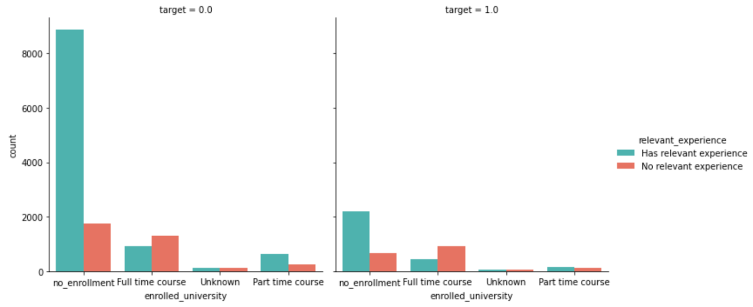
Without relevant experience, higher turnover rate Q3: Is relevant experience in the data science field required?

Slide 32
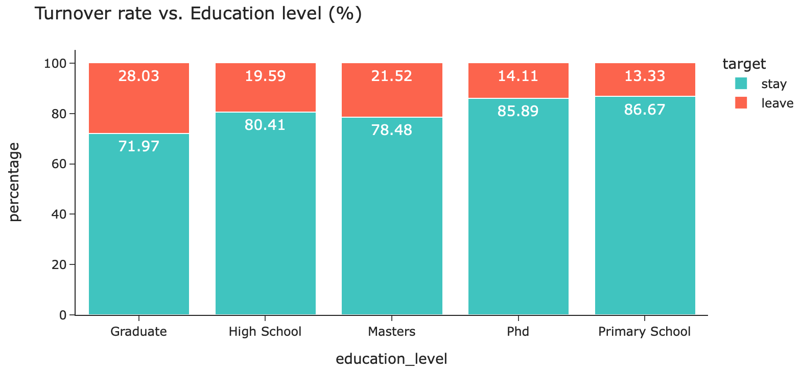
Graduates are most likely to try new jobs. Q5: Which educational level wants to look for a new job the most?

Slide 33
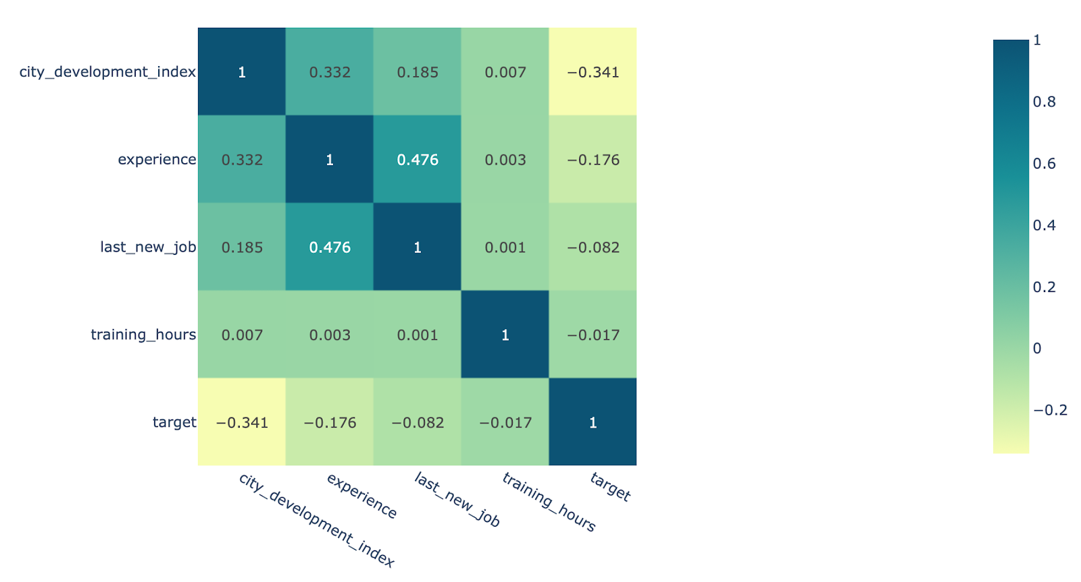
Numerical attributes correlation Q6: Which are the key factors that affect the trainees’ decision?
CDI
experience
experience
target
last_new_job
experience
last_new_job
target

Slide 34
06
Modeling
Try different types of model to predict the labels.

Slide 35


Machine Learning Algorithm
01
03
02
04
K Neareast Neighbors
Optimized Logistic
Regression with PCA
Logistic Regression
Decision Tree Classifier

Slide 36

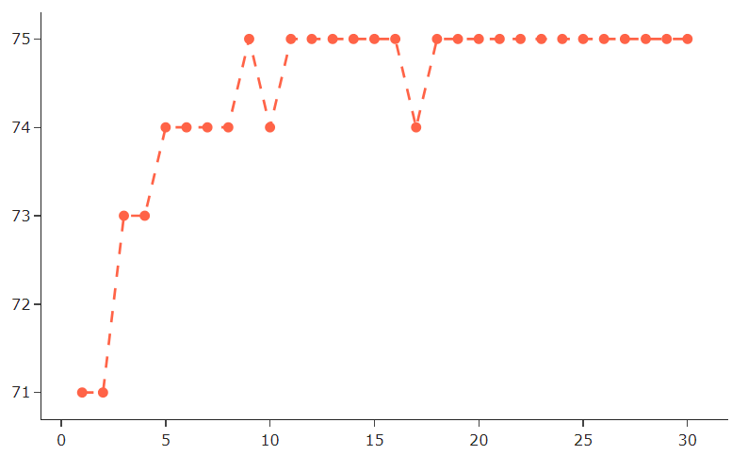
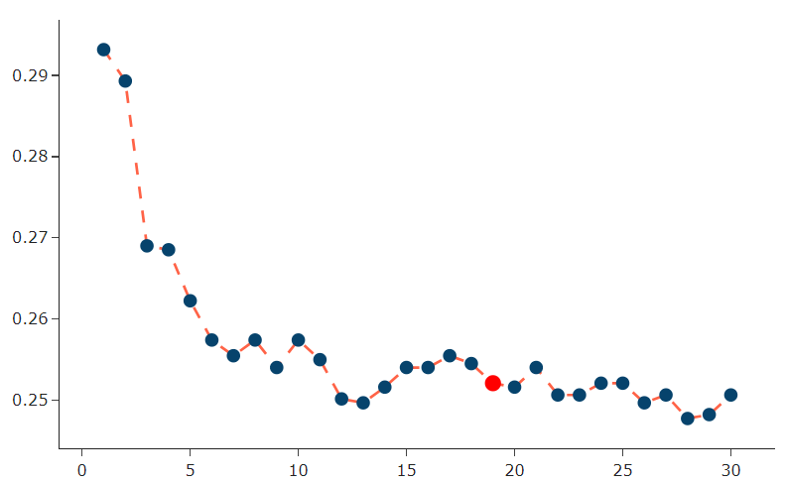
KNN
accuracy
mean absolute error
One of the simplest algorithms to learn
Supervised learning method that can be used for classification and regression
Works based on the number of nearest neighbors

Slide 37

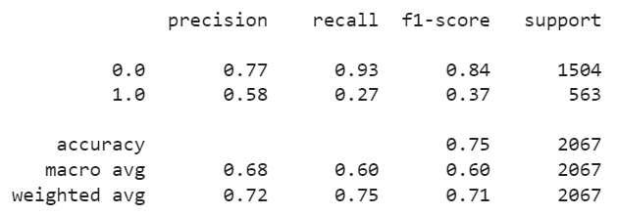
Logistic Regression
Supervised learning method, used for binary classification
Run faster than KNN
Show the linear coefficients of random variables.
75%

Slide 38
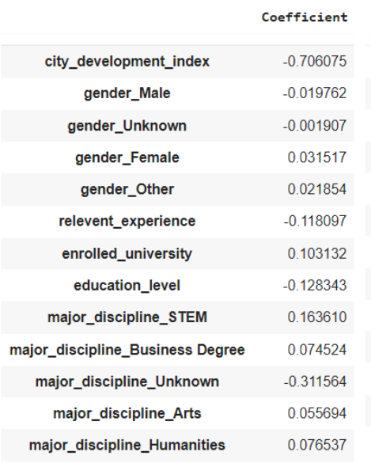
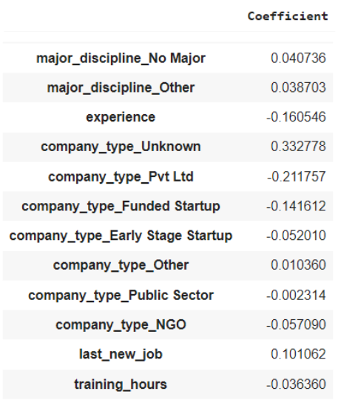
Logistic Regression

Slide 39
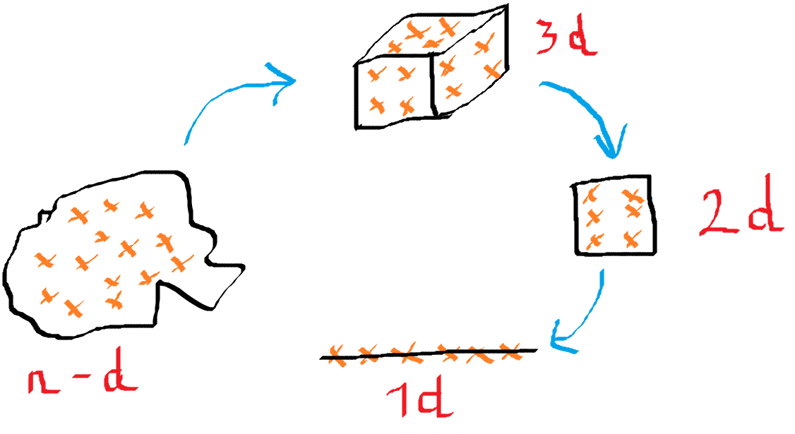
PCA
Principal components Analysis, reduces dimensionality in big data set.
Extract a smaller set that still contains most of the information

Slide 40
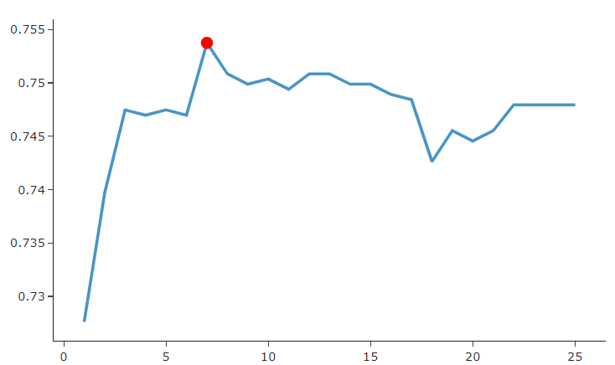
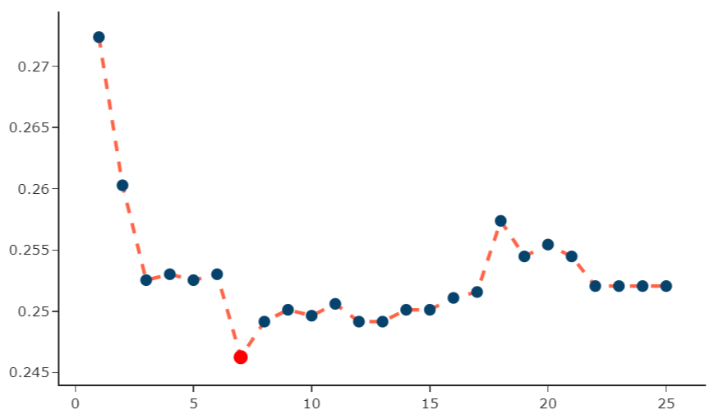
LR-PCA
accuracy
mean absolute error
Find the best num of principal components that hold the data with the lowest error

Slide 41
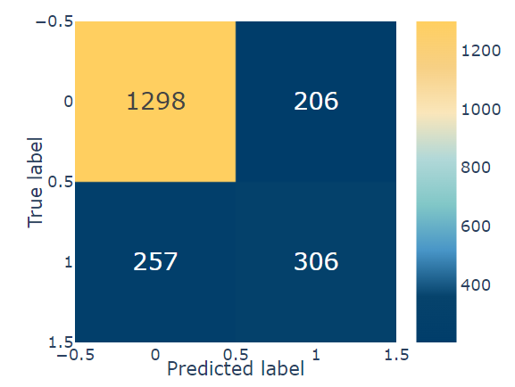
Decision Tree
77.6%
A supervised machine learning algorithm used for regression and classification.
Each leaf node represents a class label, internal node of the tree corresponds to attributes.

Slide 42
07
Conclusions

Slide 43

Summary
Stay | Leave
CDI: high ( > 0.7 ) Gender: male Relevant experience: ✔️ Current university courses enrollment: ✘ | Educational level: Graduate Relevant experience: ✘ Current university courses enrollment: ✔️

Slide 44
1
2
Conclusions
Limitations
Our project lacks the choice for the best model and the error is a little bit high.
Future Plans
Involve more types of model, including other platform such as: Tableau, ...
Use the model to predict real-life data.

Slide 45
References
Lalwani, P (2021). What Is HR Analytics? Definition, Importance, Key Metrics, Data Requirements, and Implementation | Spiceworks
HR Analytics: Job Change of Data Scientists. (n.d.). Kaggle
Jaadi, Z. (2022). Principal Component Analysis (PCA) Explained. Built In. AUTHOR (YEAR)
Decision Tree Introduction with example. (2022, November 10). GeeksforGeeks
Varghese, D. (n.d.). Comparative Study on Classic Machine learning Algorithms | by Danny Varghese. Towards Data Science.

Slide 46


Thank you!
Please keep this slide for attribution.

